Slide 1

CAKE
https://cakebuild.net

Slide 2
Who am I?

Slide 3













The team

Slide 4

The problem
“Works on my machine!”
“Works on CI server!”
“Builds? That’s Bob’s job!”

Slide 5
Dependency based programming
Define tasks as discrete unit of work
Order is decided by dependencies
First introduced in Make (1976)
Nmake, Rake, MSBuild, NAnt, Psake, FAKE, Cake, Bau, Nuke…

Slide 6
Dependency based programming
Clean
Unit Tests
Static Analysis
Packaging
Build
Deploy
Calculate
Version

Slide 7
Dependency based programming
Clean
Calculate
Version
Build
Static Analysis
Build Server
Default
Unit Tests
Packaging
Deploy

Slide 8
Alternatives
Deploy by hand
Low bus factor
Risky
Not possible to automate

Slide 9
Alternatives
Scripts
Difficult to maintain
Easily becomes spaghetti
Often not cross platform

Slide 10
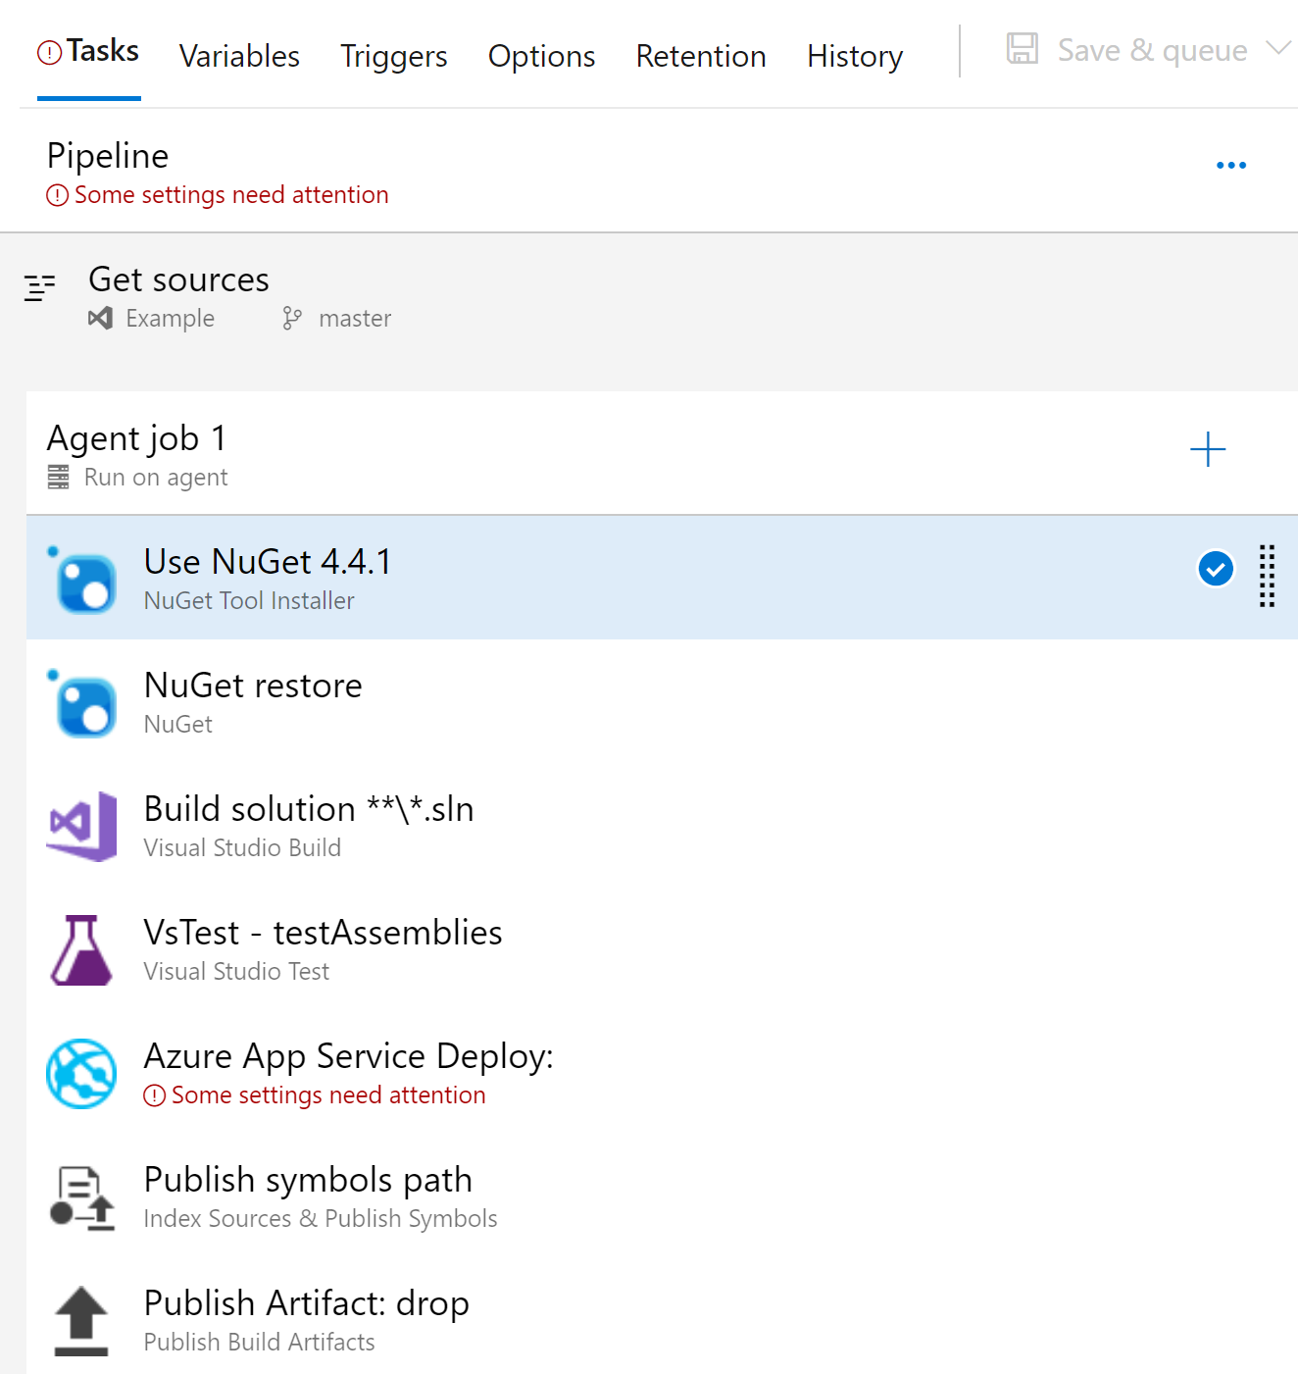
Alternatives
CI server
No local builds
Difficult to “get right”
Vendor lock-in
Difficult to debug
In some cases not under source control

Slide 11
What is Cake?
A build automation system
Write your build scripts in C#
Statically typed. Compiled.
Runs on .NET Framework (net461) and .NET Core (netcoreapp20)
Powered by Roslyn

Slide 12


What is Cake?
Open Source
MIT licensed
Available on GitHub https://github.com/cake-build/cake
Part of the .NET Foundation
Project guidance and mentoring
IP and legal

Slide 13
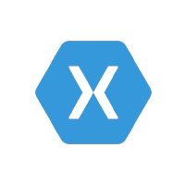



Some Notable users
Microsoft
Xamarin
GitHub
Octopus Deploy
Omnisharp, Identity Server, Nunit, Nancy, NSubstitute, MVVMCross, ReactiveUI, FluentAssertions, Polly, Hangfire and more...

Slide 14
Some numbers
2,952,180 installs
94 releases
2473 commits
1026 Pull Requests
152 contributors
+200 external developed addins and modules

Slide 15
Why use cake?
It’s C#
Statically typed, Compiled
Supports a lot of third party tools and scenarios out-of-the-box.
Unit test frameworks, build tools, ci servers, package managers, deploy systems, install systems, code coverage etc. etc.
Everything you can do with .NET framework or .NET Core, you can do in Cake!

Slide 16
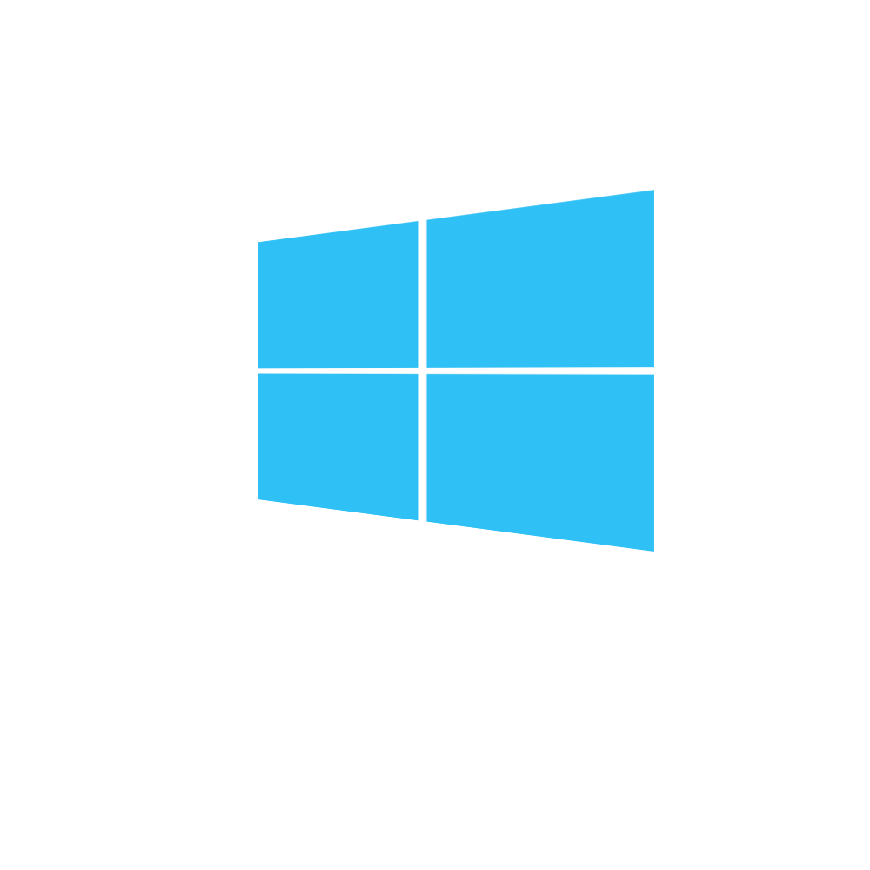







Cross platform
Windows
Linux
MacOS
Docker

Slide 17
Cross framework
.NET Framework
net461
.NET Core
netcoreapp20, netcoreapp21, netstandard20
Mono
4.4.2

Slide 18
Cross environment
AppVeyor
Bamboo
BitBucket Pipelines
Bitrise
Continua CI
GitLab CI
Go CD
Jenkins
MyGet
TeamCity
TFS / Azure DevOps
Travis CI
DEVELOPER MACHINE

Slide 19
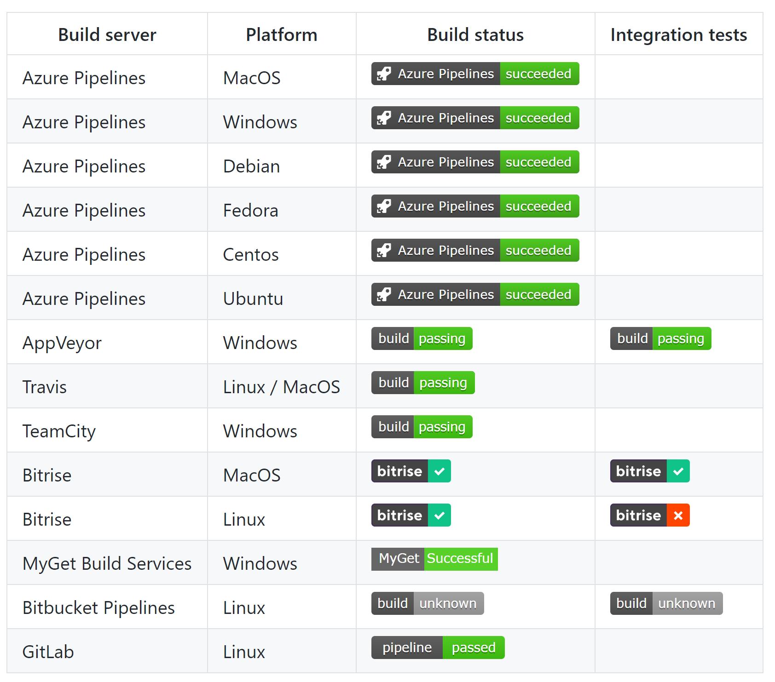
Building Cake with cake
Built-in support for 12 different CI servers. (we build and test Cake on 8 CI servers and 7 operating systems to ensure cross platform fidelity)

Slide 20
Why use cake?
Works the same locally and on build servers
Abstracts differences like the file system on different platforms
Also contains test utilities like a virtual file system to unit test addins, modules and even Cake scripts.
Build scripts versioned with source code

Slide 21
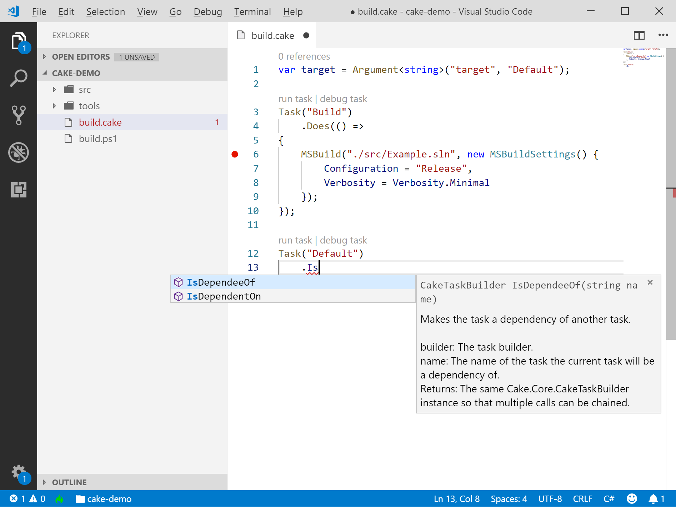
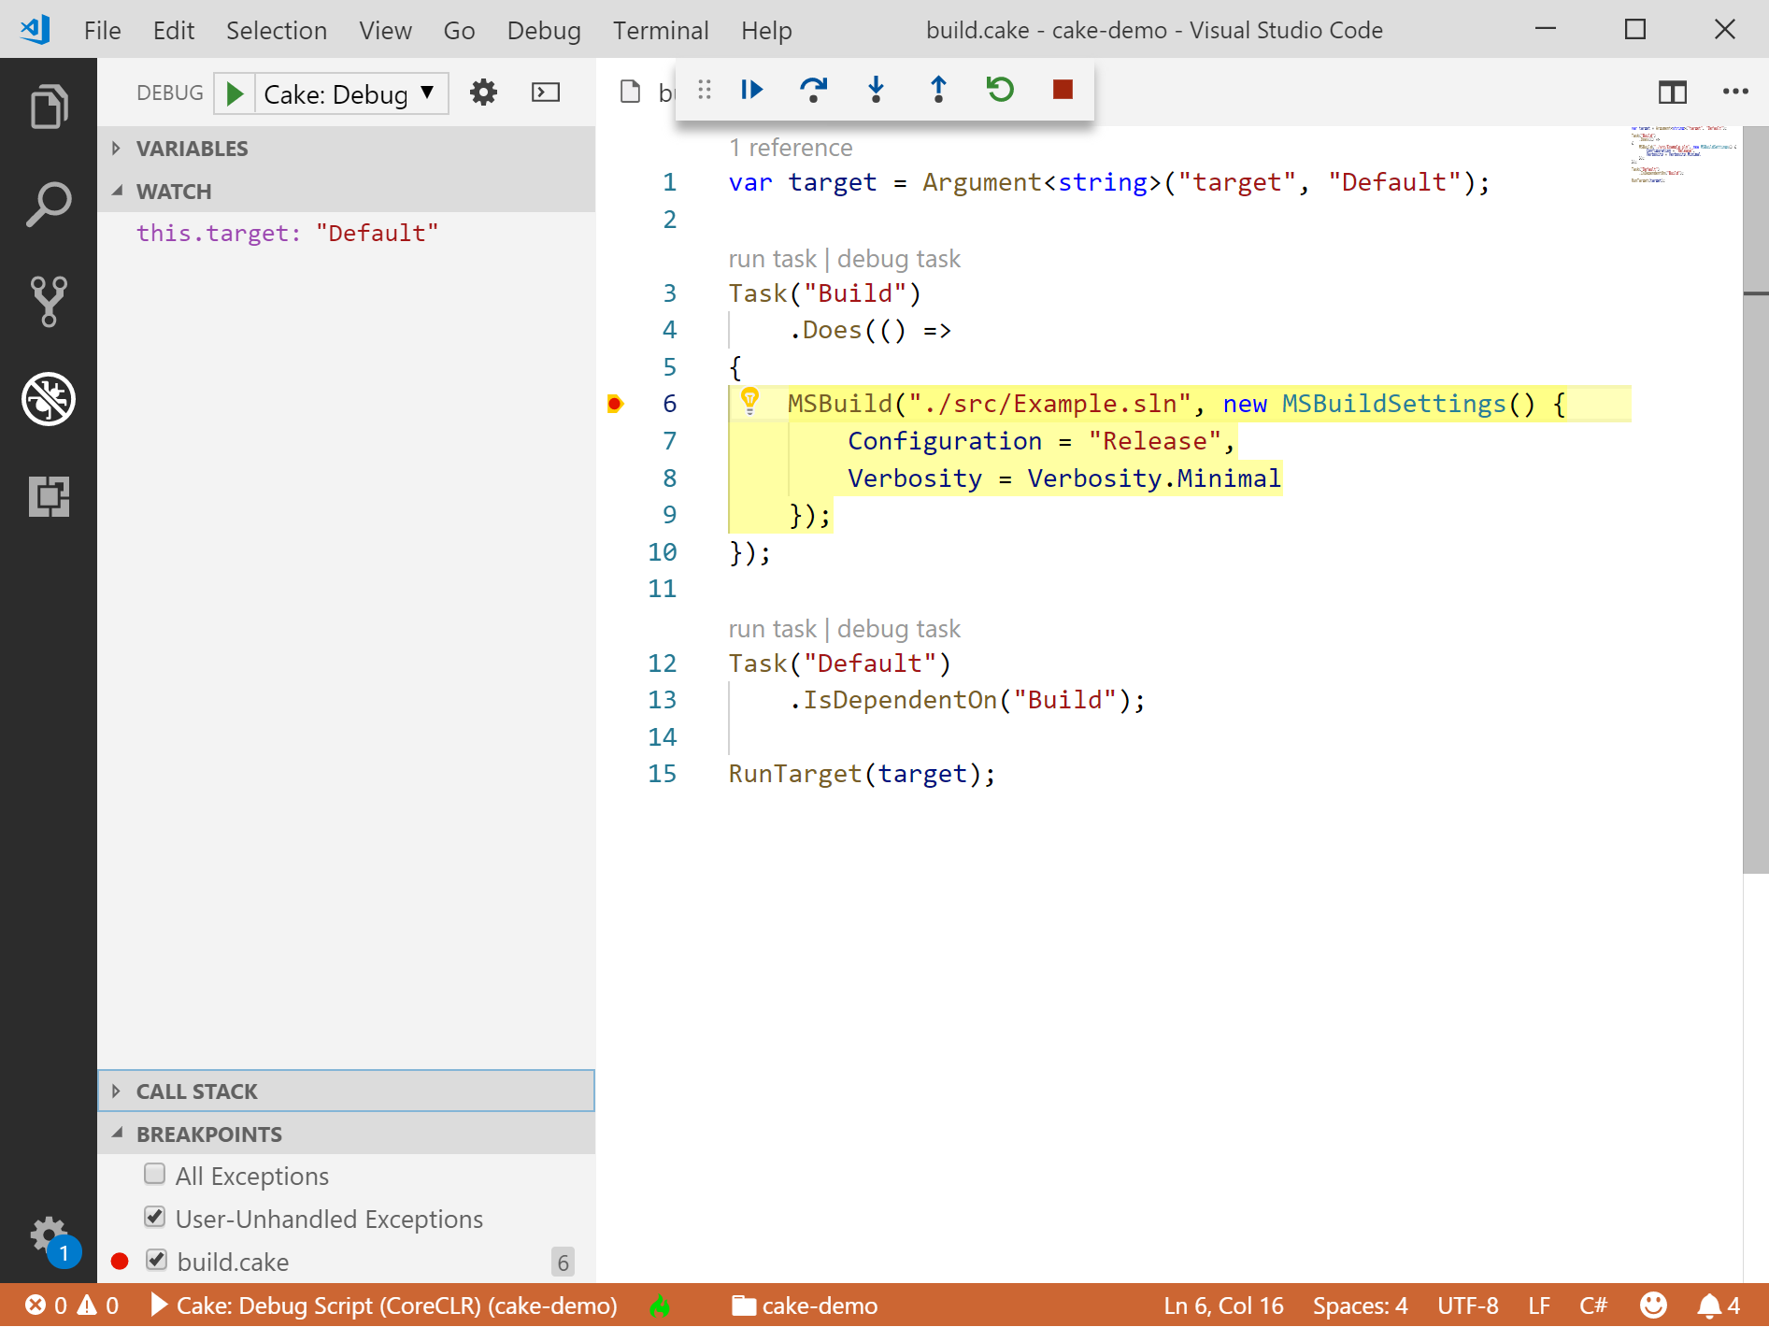
VS Code integration

Slide 22
A healthy community
Has a GREAT community!
Easy and fast to get help
Someone else have probably already encountered your problem

Slide 23
Philosophy
Increase team productivity
Decrease complexity of development and CI/CD
Build scripts and configurations in repository
No binaries or sensitive information in repository

Slide 24
Philosophy
Non-intrusive
Doesn’t affect the way you or your team work
Always behaves the same way
Regardless of operating system
Regardless of environment
Regardless of build server
Notes:
It always behaves the same, but can be configured to behave differently depending on environment. “Oh, we’re not on Azure DevOps, don’t run deploy task”

Slide 25
Philosophy
Convention based…
No surprises along the way
…but also configurable
Provide your own configuration or override defaults
Implement your own tools
Replace internal parts you don’t like

Slide 26
SO HOW DOES IT WORK?
Cake file
Normally (by convention) called build.cake
Build script logic goes here
Bootstrapper
Normally a PowerShell (build.ps1) or Bash script (build.sh)
Responsible for “setting everything up”
Notes:
Also: Docker, Dotnet tool, Chocolatey, Homebrew

Slide 27
SO HOW DOES IT WORK?
Inputs
Environment variables
Configuration file (cake.config)
Command line arguments

Slide 28
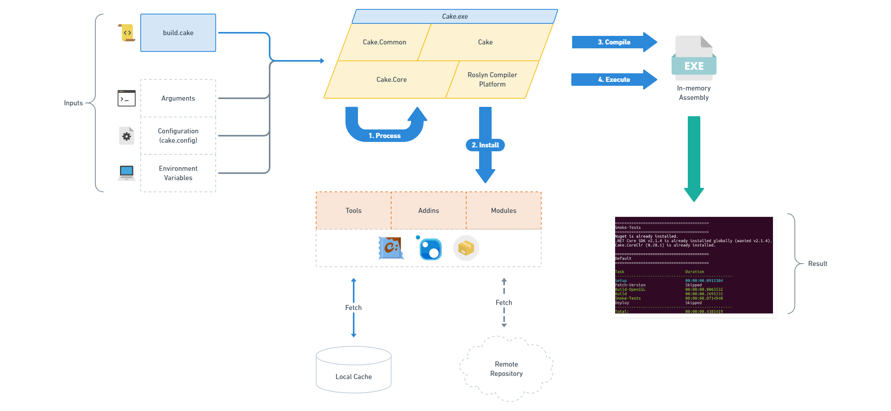
So how does it work?

Slide 29
Extensibility
Script files
Addins
Tools
Modules
Allows you to replace anything in Cake

Slide 30
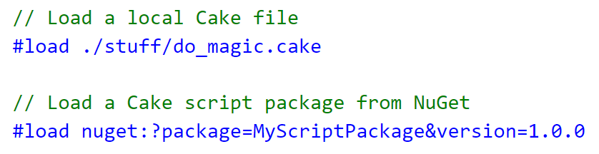
Script files

Slide 31
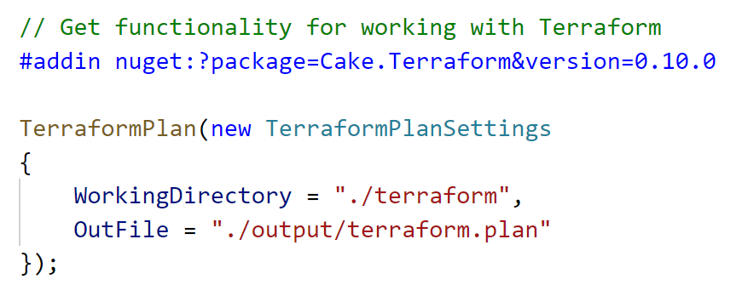
Addins

Slide 32
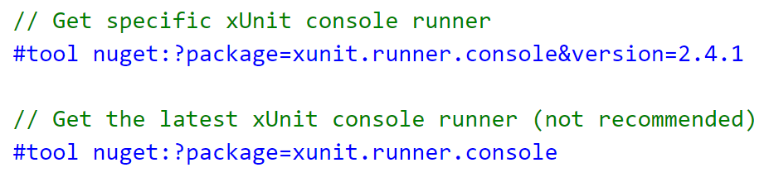
Tools

Slide 33
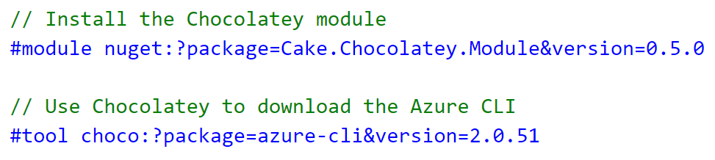
Modules

Slide 34
PACKAGE PROVIDERS
Use the pre-processor directives to tell Cake how to use something
provider:[//authority]?package=myapp&version=1.1
Easy to implement your own provider
skandia://?package=foo&prerelease
NuGet provider is built in, but others are available as external modules such as npm, dotnet, apt

Slide 35
demo
Clean
Calculate
Version
Build
Static Analysis
Build Server
Default
Unit Tests
Packaging
Deploy

Slide 36
Getting help
GitHub
https://github.com/cake-build/cake/issues
Gitter
https://gitter.im/cake-build/cake
Documentation
https://cakebuild.net
StackOverflow
Use tag cake-build
Notes:
Tons of information at Cake’s homepage.

Slide 37
Want to Contribute?
Code
Find an open issue
Get buy-in to work on it
Submit a pull request
Push early
Found a bug?
We would love hearing about it!

Slide 38
Want to Contribute?
Documentation
Fixing typos
Code samples
Documentation
Answer questions
Gitter
StackOverflow
Issues

Slide 39
Questions?

Slide 40
Thank you!

